Slide 1
GrowthForecast
Grant Adams

Slide 2
Data setup
# Load data and packages library(GrowthForecast) library(dplyr) library(ggplot2) # Observed data ---- data(LWA) # Select species and region pollock <- LWA %>% dplyr::filter(CN == "walleye pollock" & REGION == "GOA") %>% dplyr::select(YEAR, age, weight, Temp) %>% dplyr::mutate(weight = weight/1000) # Grams to kg colnames(pollock) <- tolower(colnames(pollock))

Slide 3
Fit and compare forecasts
pollockforecast <- ForecastGrowth( form = formula(weight~age+year), # Data including covariates data = pollock, n_proj_years = 4, # Number of projection years to evaluate peels = 3 # Number of retrospective peals )

Slide 4
Performance metrics
$RMSE=\sqrt{∑{\left({\hat{W}}_{a,\hat{y}}−W_{a,y}\right)}^{2}/N}$
Age-specific RMSE
RMSE across ages
SSB and catch RMSE?

Slide 5
Query output
names(pollockforecast)
[1] "all_predictions" "all_forecasts" "rmse_table" [4] "rmse_table_by_age" "best_mods" "best_mods_by_age" [7] "best_mods_by_mat" "best_forecast" "plots"

Slide 6
Best model according to RMSE
YID | model | RMSE
y+1 | WtAgeRe | NA
y+2 | WtAgeRe | 0.2290
y+3 | WtAgeRe | NA
y+4 | WtAgeRe | 0.2374
kable(pollockforecast$best_mods)

Slide 7
Predicted weight-at-age
year | 1 | 2 | 3 | 4 | 5 | 6 | 7 | 8 | 9 | 10 | 11 | 12 | 13 | 14 | 15 | 16 | 17 | 18 | model
2022 | 0.03 | 0.1 | 0.18 | 0.27 | 0.46 | 0.63 | 0.84 | 0.95 | 1.03 | 1.09 | 1.15 | 1.17 | 1.36 | 1.47 | 1.56 | 1.68 | 1.73 | 1.73 | #WtAgeRe
2023 | 0.03 | 0.1 | 0.22 | 0.33 | 0.43 | 0.64 | 0.81 | 1.01 | 1.11 | 1.18 | 1.22 | 1.27 | 1.28 | 1.46 | 1.55 | 1.63 | 1.74 | 1.78 | #WtAgeRe
2024 | 0.03 | 0.1 | 0.22 | 0.37 | 0.50 | 0.61 | 0.81 | 0.98 | 1.17 | 1.26 | 1.31 | 1.34 | 1.38 | 1.37 | 1.54 | 1.62 | 1.69 | 1.80 | #WtAgeRe
2025 | 0.03 | 0.1 | 0.22 | 0.37 | 0.53 | 0.67 | 0.79 | 0.98 | 1.14 | 1.31 | 1.39 | 1.43 | 1.45 | 1.47 | 1.46 | 1.61 | 1.68 | 1.74 | #WtAgeRe
kable(pollockforecast$best_forecast, digits = 2)

Slide 8
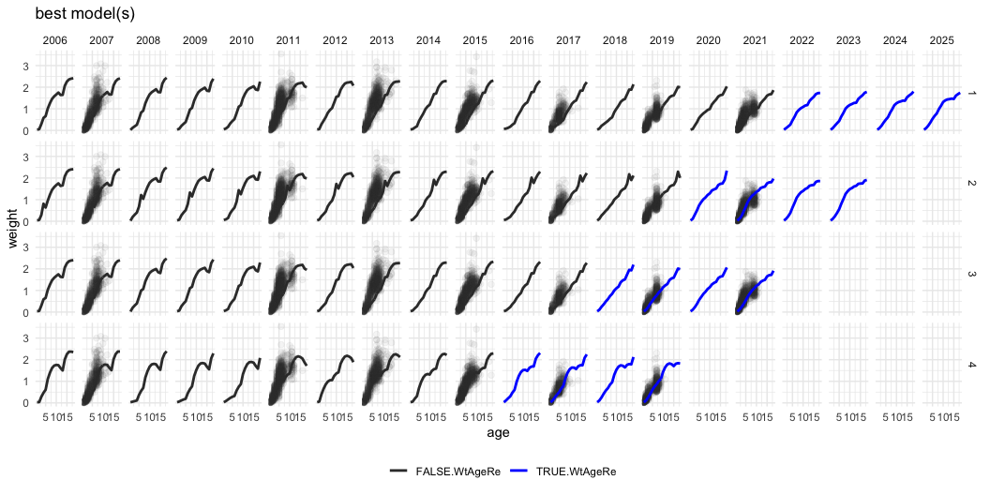
Plot
pollockforecast$plots$projection

